Slide 1
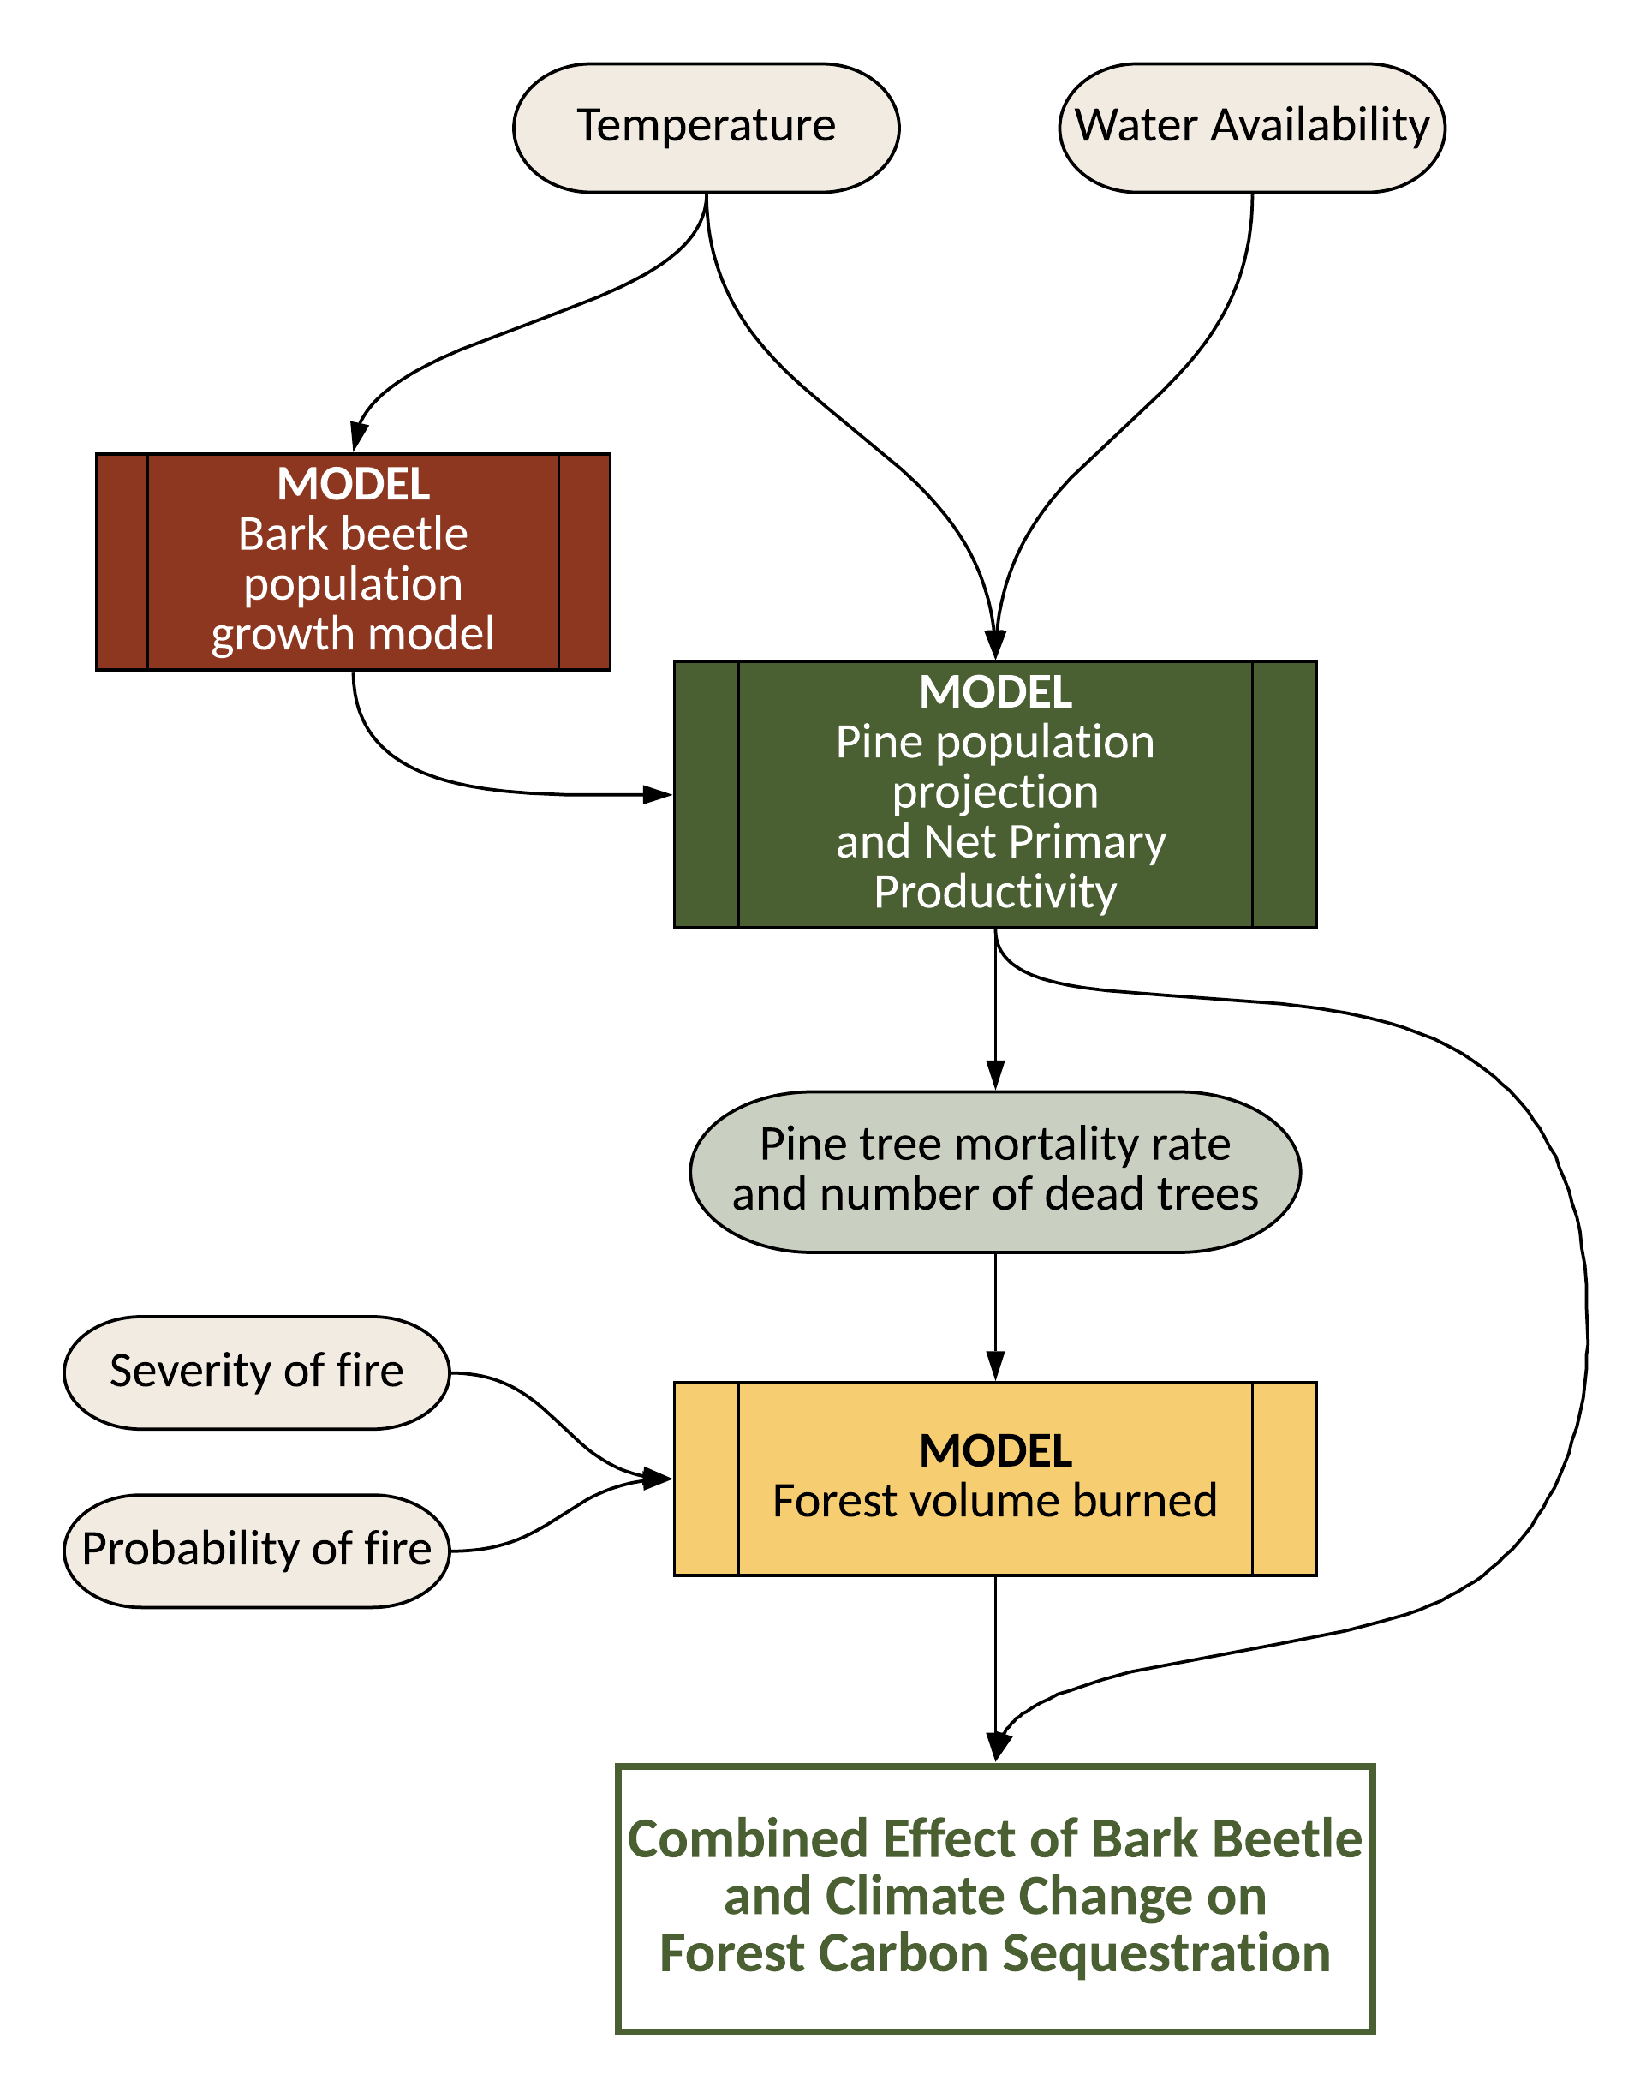
Estimating the combined effect of bark beetle and
climate change on forest carbon sequestration

